Slide 1
Applying Image Recognition to Enhance Fisheries Management Capabilities
Tzofi Klinghoffer
Collaborators: Robert Vincent, Caleb Perez, Paris Perdikaris, Chrys Chryssostomidis
Healthy Oceans
Massachusetts Institute of Technology Sea Grant

Slide 2
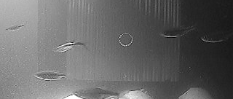
How Many Herring?

Slide 3
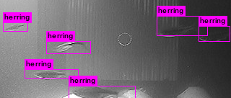
Image Recognition Solution: 6 herring found in 0.01 seconds

Slide 4
Today’s Presentation
Objective
Background
Current Technique
Applying Image Recognition
Results
Conclusion
Future Work
References

Slide 5
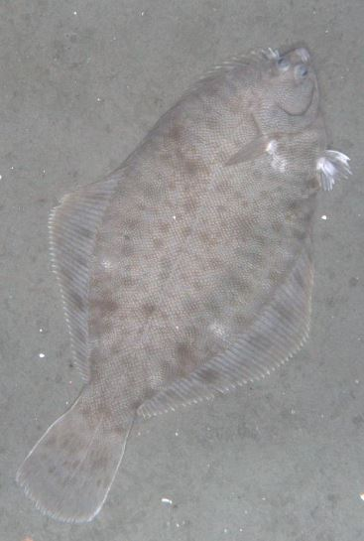
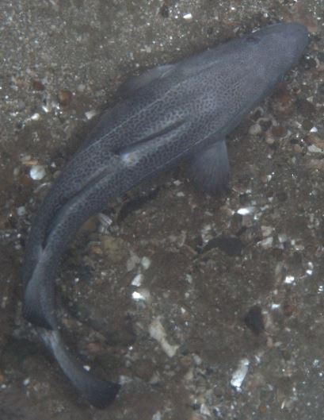
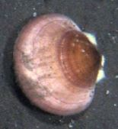
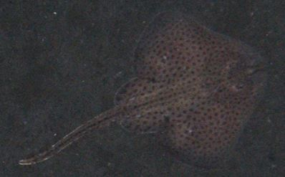
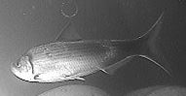
Objective
To automate the detection and counting of relevant fisheries species in image and video data through image recognition
Relevant fisheries species:
Alewife Herring /Blue Back Herring
(Alosa pseudoharengus / Alosa aestivalis)
Atlantic Sea Scallops
(Placopecten magellanicus)
Skates
(Rajidae)
Flatfish, such as flounder
(Pleuronectiformes)
Various round fish species

Slide 6
Background
“The world’s finest wilderness lies beneath the waves …”
— Robert Wyland, Marine Life Artist
Marine fisheries populations have a large impact on the U.S. economy
The fishing industry contributes about $90 million and 1.5 million jobs to the U.S. economy [1]
In 2014, 17% of the U.S. fisheries were classified as overfished [1]
Therefore, NOAA Fisheries Management is interested in monitoring relevant species populations

Slide 7
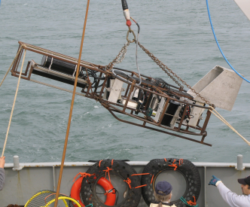
Current Technique: Gather
1. Gather [underwater photographs]
Habitat Mapping Camera System (HabCam)

Slide 8
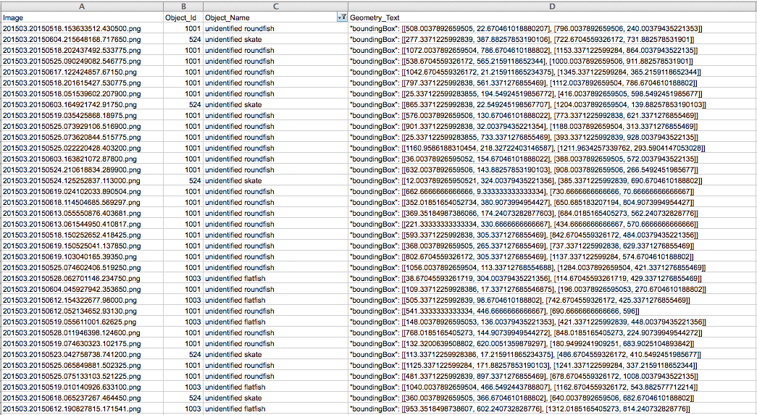
Current Technique: Manually Annotate
2. Manually Annotate [underwater photographs]
Notes:
Define bounding box

Slide 9
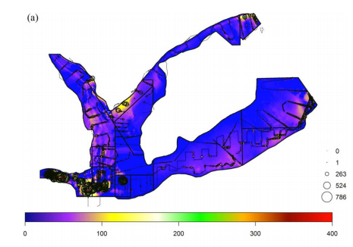
Current Technique: Extrapolate
3. Extrapolate [population estimates]
[2] Chang et al. 2017

Slide 10
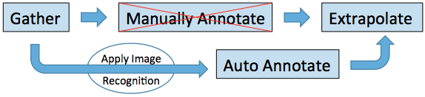
Applying Image Recognition
Can image recognition be used to accurately detect and count fisheries species?
How many iterations of training are needed to yield accurate results?
How does the quality of annotations used in training impact accuracy?

Slide 11
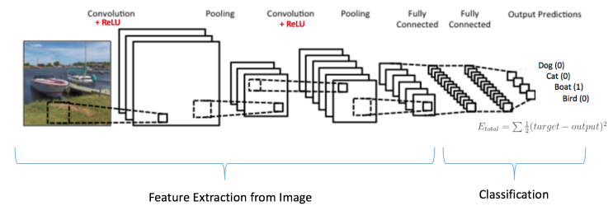
Appling Image Recognition: Convolutional Neural Networks
Loosely based on biological neural networks
Notes:
Rectified linear unit (ReLU) → non linear function, converts negatives to zero

Slide 12
Applying Image Recognition: Materials
Hardware | Software
1 x Intel Xeon CPU E5-2623 v4, 2.60GHz | You Only Look Once (YOLO) v2 Real-Time Object Detection
4 x NVIDIA Titan X GPU | LabelImg Graphical Image Annotation Tool
1 x Toshiba 1 TB Canvio Slim II Hard Drive | Fedora 25 Linux Operating System

Slide 13
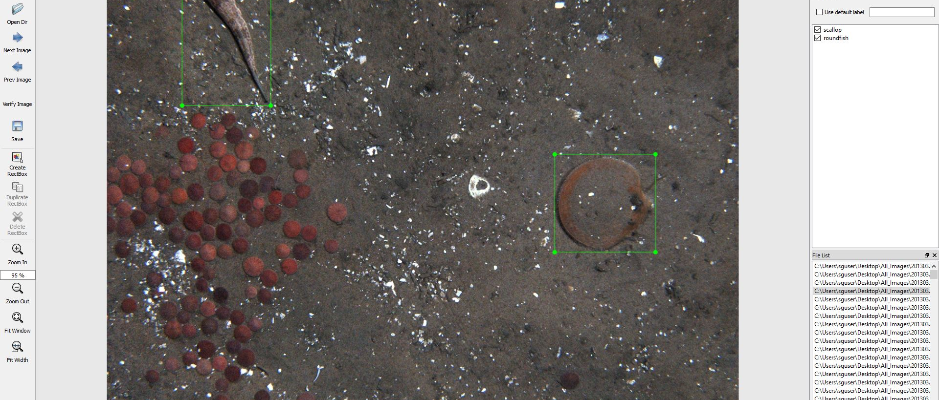
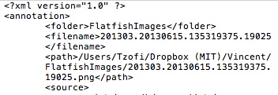
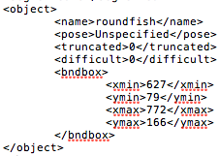

Applying Image Recognition: Methodology – Gather & annotate

Slide 14
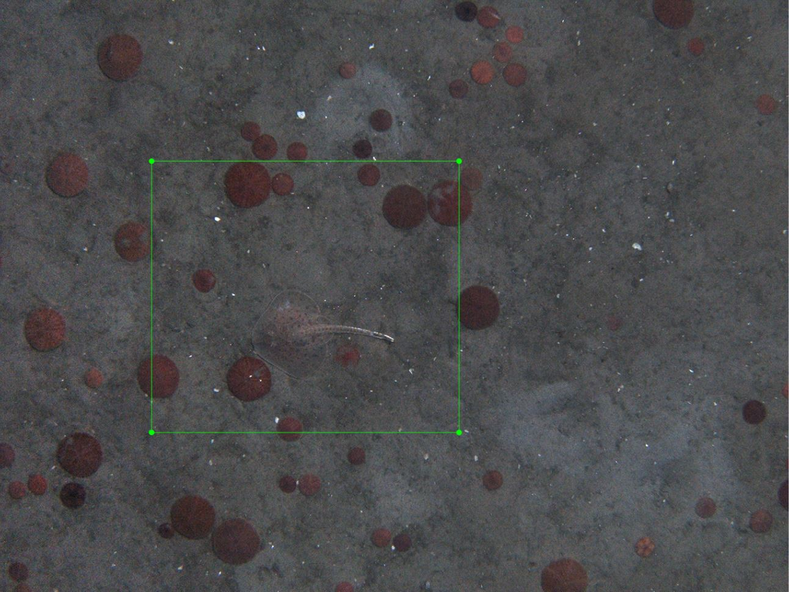
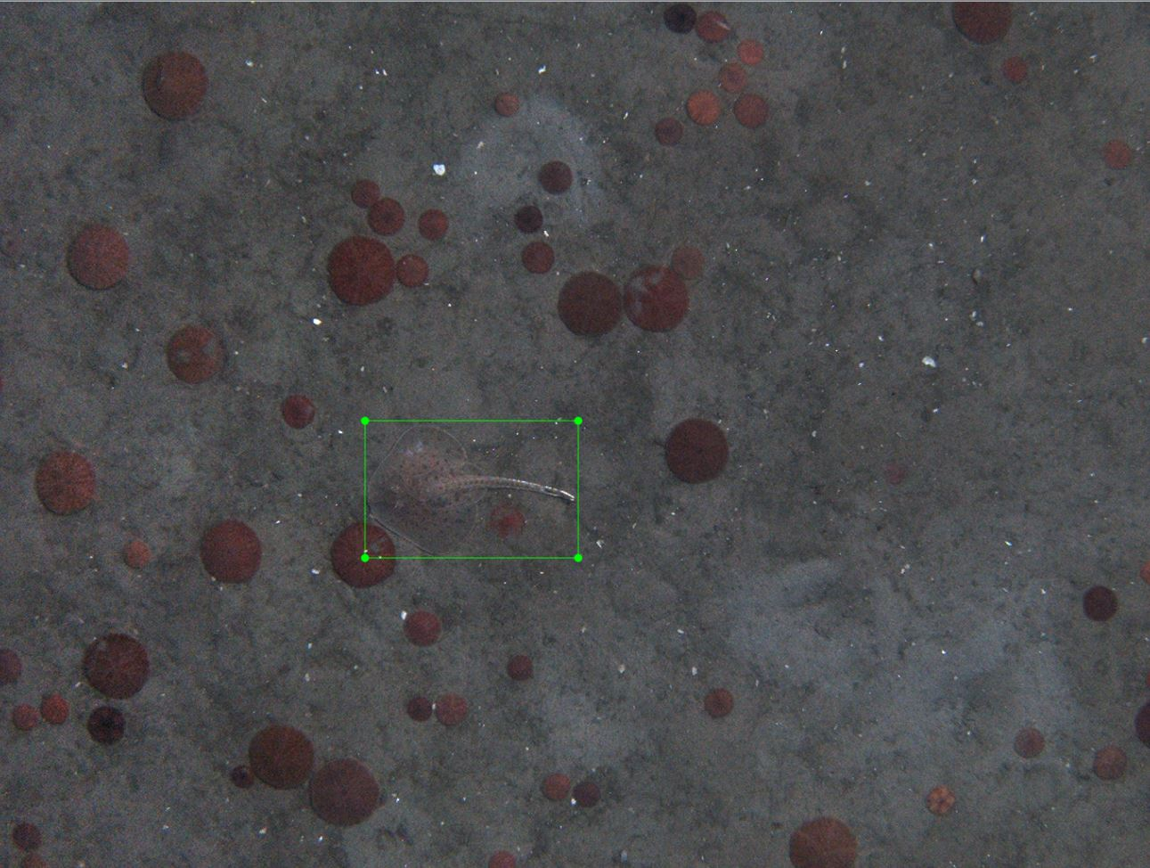
Applying Image Recognition: Methodology – Train
Train YOLOv2 Real-Time Object Detection algorithm:
Original training set: 5,063 images
Adjusted training set: 5,063 images
Notes:
Both training sets include ~2000 well annotated images that we created. ~3000 were pulled from National Fisheries manual annotations spreadsheet

Slide 15
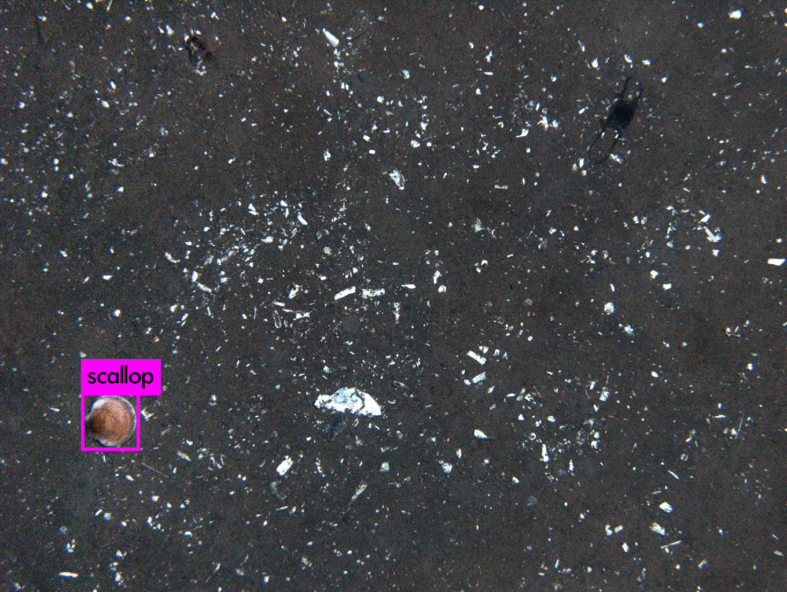
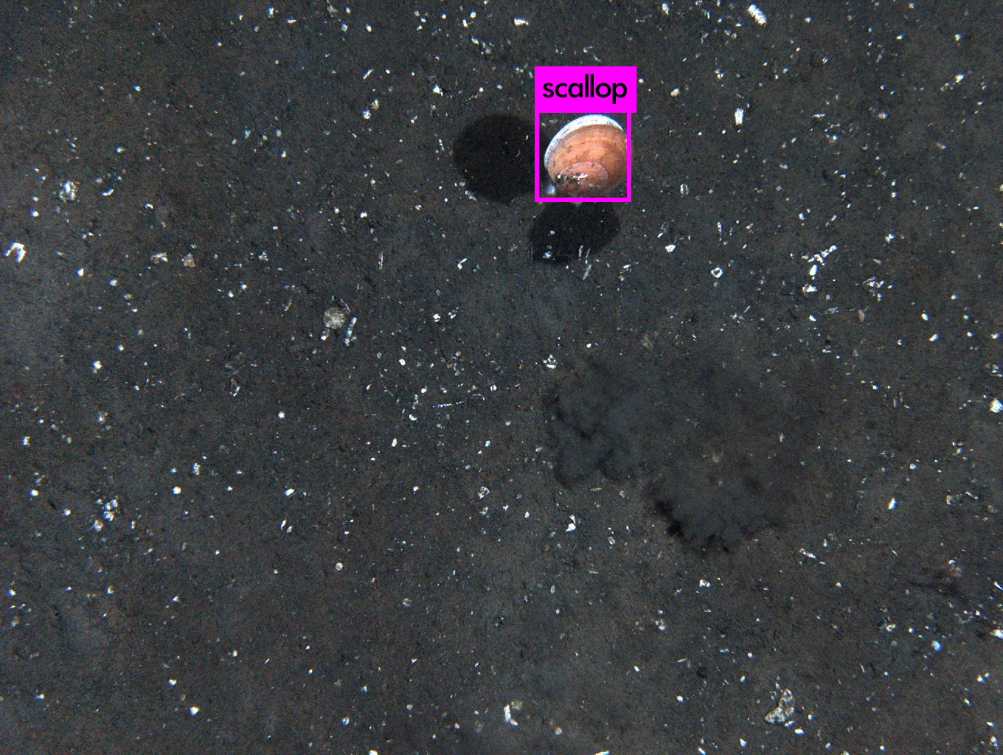
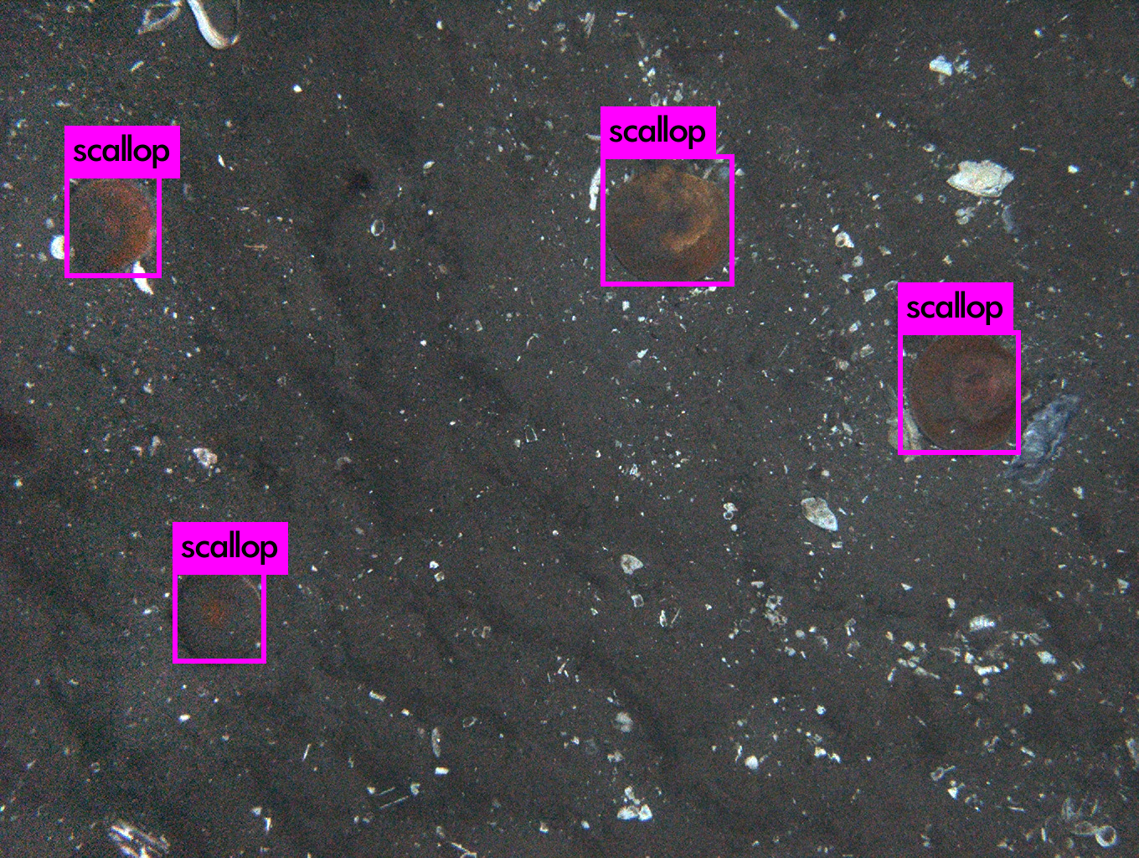
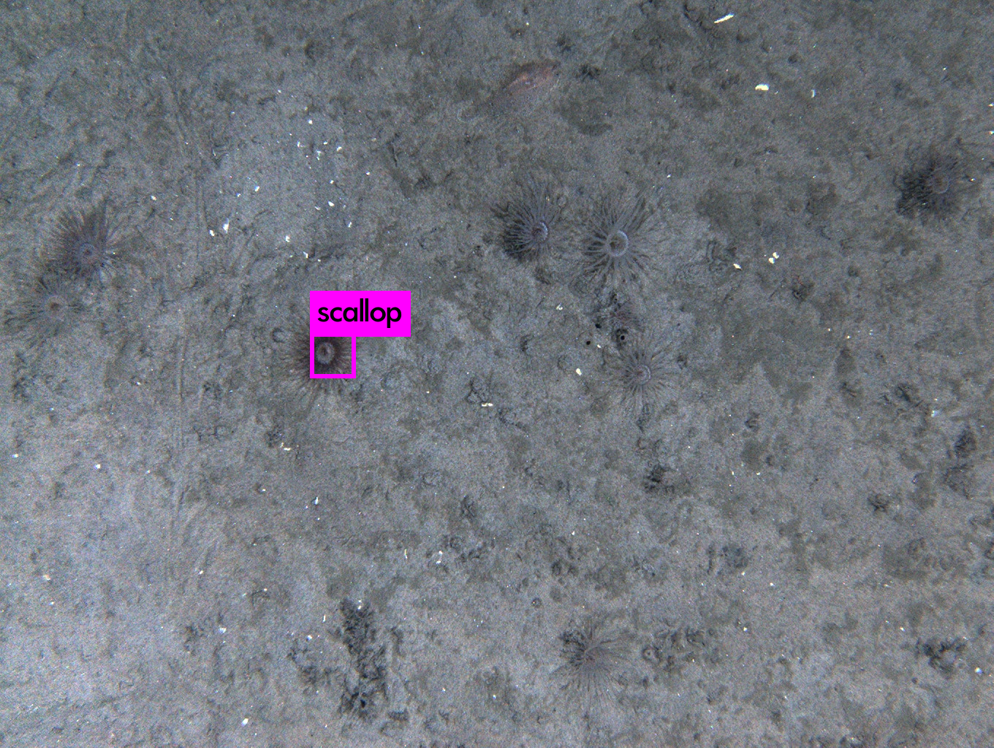
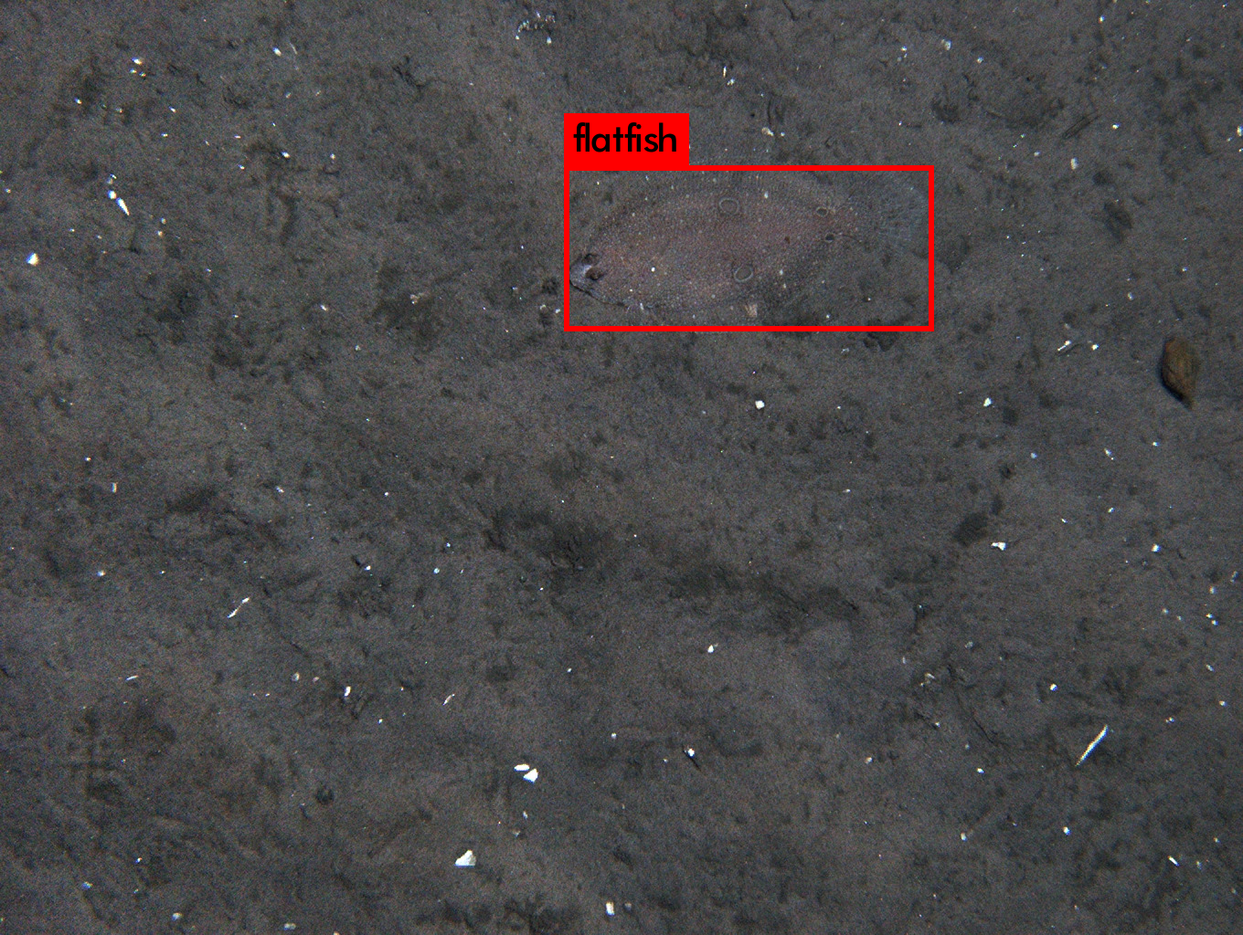
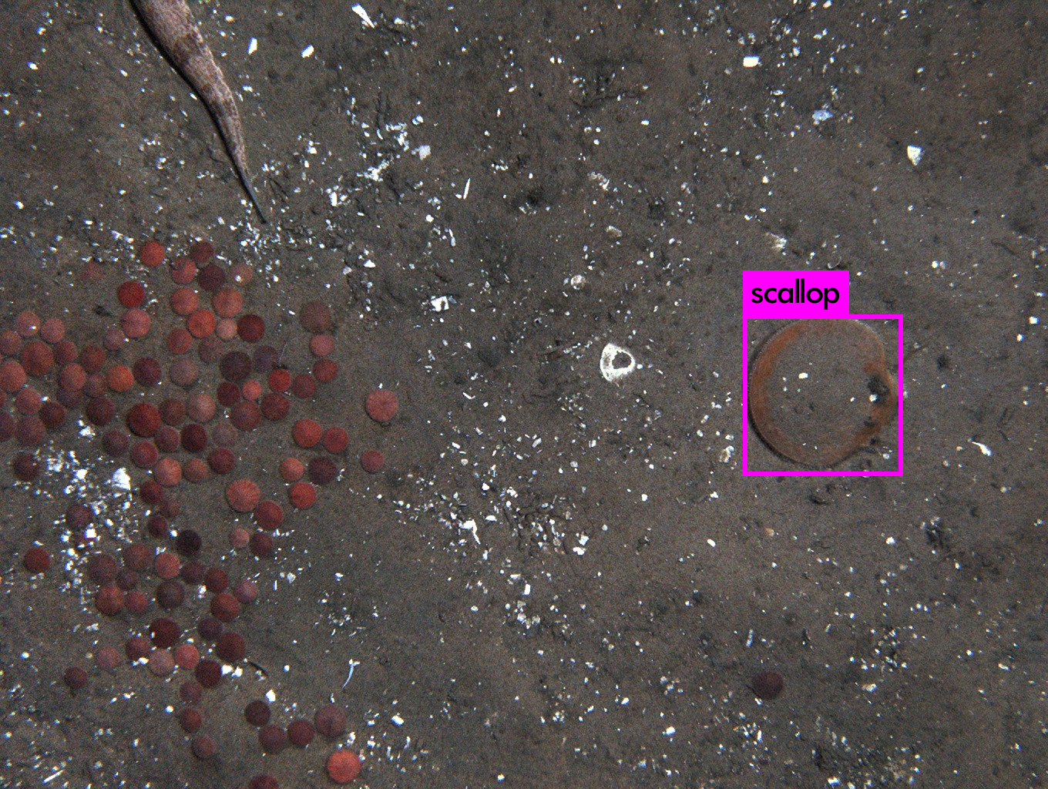
Applying Image Recognition: Methodology – Test
Run trained YOLOv2 algorithm on 300 test images
False positives?
False negatives?

Slide 16
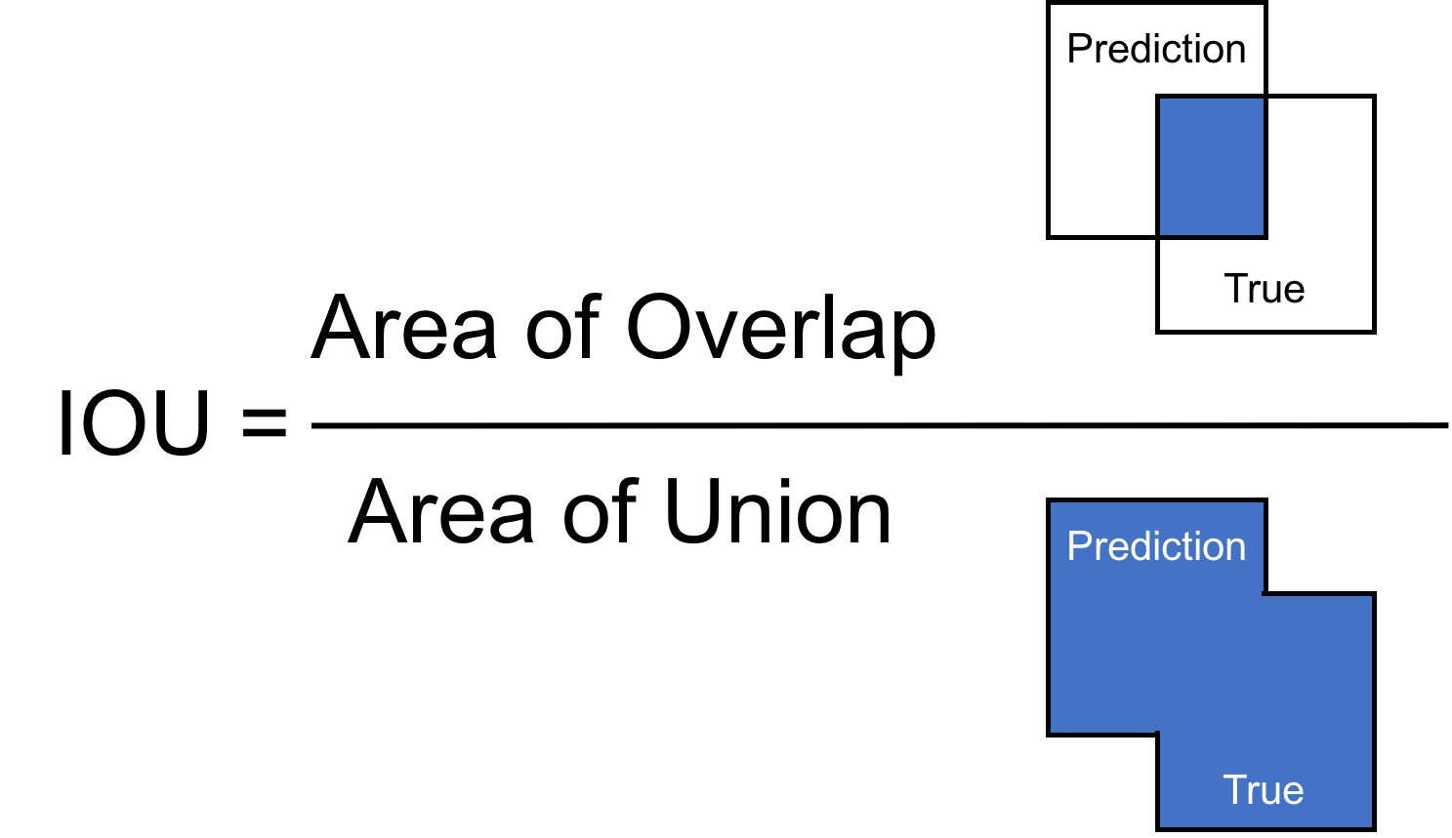
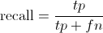
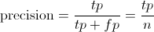
Results: Metrics
Intersection Over Union (IOU) ( % )
Recall ( % )
Precision ( % )
Notes:
IOU is how much the predicted bounding box overlaps with the true bounding box

Slide 17
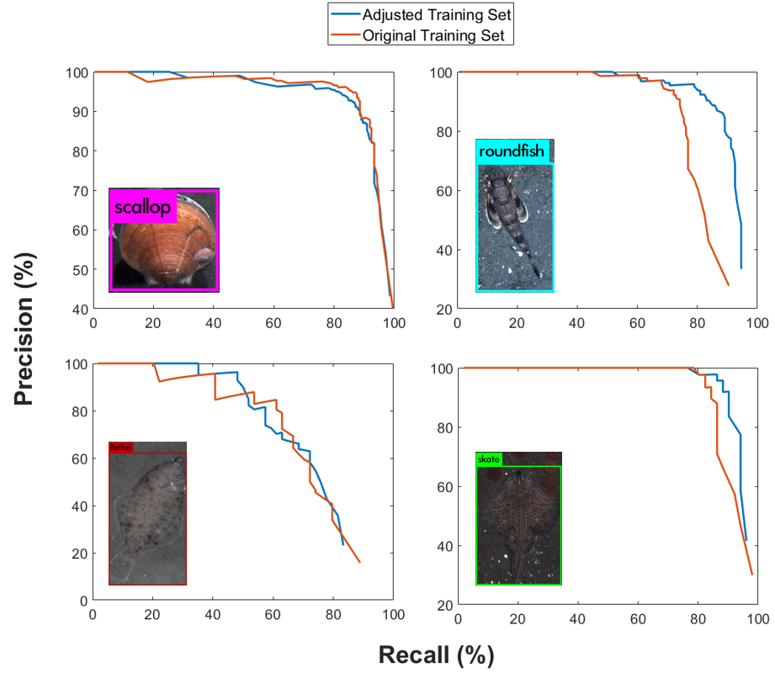
Results
Can image recognition be used to accurately detect and count marine species?

Slide 18
Results
How many iterations of training are needed to yield accurate results? ~2000
Notes:
2000 iterations

Slide 19
Results
How does the quality of annotations used in training impact accuracy?
IOU values averaged across all objects (N = 489) in both the adjusted and original training sets.

Slide 20
Conclusion
Deliverables: training sets, trained weights, programs for counting fisheries species
Image recognition is a viable solution to detecting and counting fisheries species in photographic data
You Only Look Once (YOLO) v2: Real-Time Object Detection software can obtain as high as 93% average recall
According to [3] Chang et al. 2016, imperfect automated annotation can be combined with human annotation
We recommend annotation guidelines be strictly followed

Slide 21
Future Work
Continue applying image recognition to herring for IRWA (Ipswich River Watershed Association)
Develop graphical user interface for end users
Test other image recognition algorithms, such as Faster R-CNN and Mask R-CNN

Slide 22
References
[1] Kearney, Melissa S., Benjamin H. Harris, and Brad Hershbein. "Economic Contributions of the U.S. Fishing Industry." Brookings. Brookings, 28 July 2016. Web. 25 July 2017.
[2] Chang, Jui‐Han, Burton V. Shank, and Deborah R. Hart. "A comparison of methods to estimate abundance and biomass from belt transect surveys." Limnology and Oceanography: Methods 15.5 (2017): 480-494.
[3] Chang, Jui-Han, et al. "Combining imperfect automated annotations of underwater images with human annotations to obtain precise and unbiased population estimates." Methods in Oceanography 17 (2016): 169-186.
[4] Redmon, Joseph, and Ali Farhadi. "YOLO9000: better, faster, stronger." arXiv preprint arXiv:1612.08242 (2016). APA
[5] Karpathy A. Convolutional Neural Networks (CNNs / ConvNets). In: Stanford University [Internet]. [cited 21 Jul 2017]. Available: http://cs231n.github.io/convolutional-networks/

